Slide 1
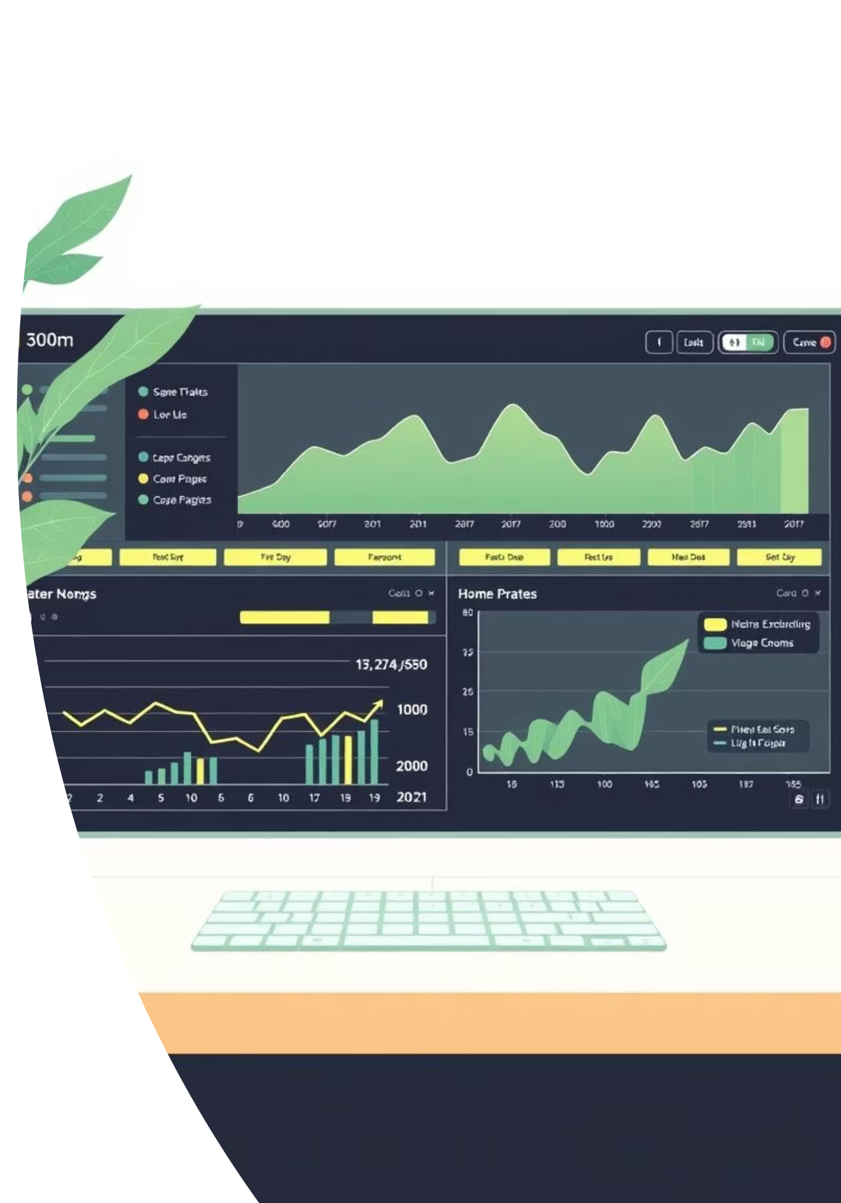
ERP Portal
Presented by-
Monty Sharma
Manish Kumar
Mohd Kasif Khan

Slide 2

Introduction to the ERP Portal
An ERP (Enterprise Resource Planning) portal is a comprehensive system designed to manage and integrate core business processes. Our project aims to streamline academic and administrative tasks such as student information, staff management, attendance, and fee collection, addressing key pain points in educational institutions.

Slide 3
Technology Stack: MERN
MongoDB
Express.js
Flexible NoSQL database for scalable data storage.
Robust backend web framework for Node.js.
React.js
Node.js
Dynamic frontend library for interactive UIs.
Efficient JavaScript runtime for server-side logic.
We chose MERN for its scalability, rapid development capabilities, and modern UI potential, complemented by tools like Bootstrap, JWT, and Redux.

Slide 4
Aims of an ERP Portal
Integrate Processes → Combine academic and administrative tasks on a single platform
Streamline Operations → Automate routine activities (attendance, fees, records)
Voice Enabled ERP → A Voice-Enabled ERP allows users to control and access ERP functions
using speech commands, a operations faster, hands-free,
and more accessible.
Improve Accuracy → Reduce manual errors in data handling
Centralized Data → Maintain student & staff information in one place
Transparency → Provide clear access to reports and records
Better Decision Making → Support management with real-time data insights
User-Friendly Access → Enable role-based dashboards for Admin,Teacher, Principal,Cordinator.

Slide 5
Modules
Admin Portal
Principal Portal
Teacher Portal
Centralized dashboard for managing students, teachers, employees, attendance, and schedules.
Centralized oversight of student and teacher activities.
Efficient tools for managing student attendance and progress.
Coordinator Portal
Seamless management of student inquiries and admissions.

Slide 6
Mapped SDG (Sustainable Development Goal)
SDG 4: Quality Education – Enhancing learning management and administration.
SDG 9: Industry, Innovation, and Infrastructure – Building a modern, scalable ERP system.
SDG 8: Decent Work and Economic Growth – By improving organizational efficiency.

Slide 7
Timeline of Project:
Phase | Timeline
Problem Identification | Month 1
Requirement Analysis & System Design | Month 1–2
Implementation (Coding) | Month 2–4
Testing & Debugging | Month 4–5
Final Deployment & Report | Month 5

Slide 8
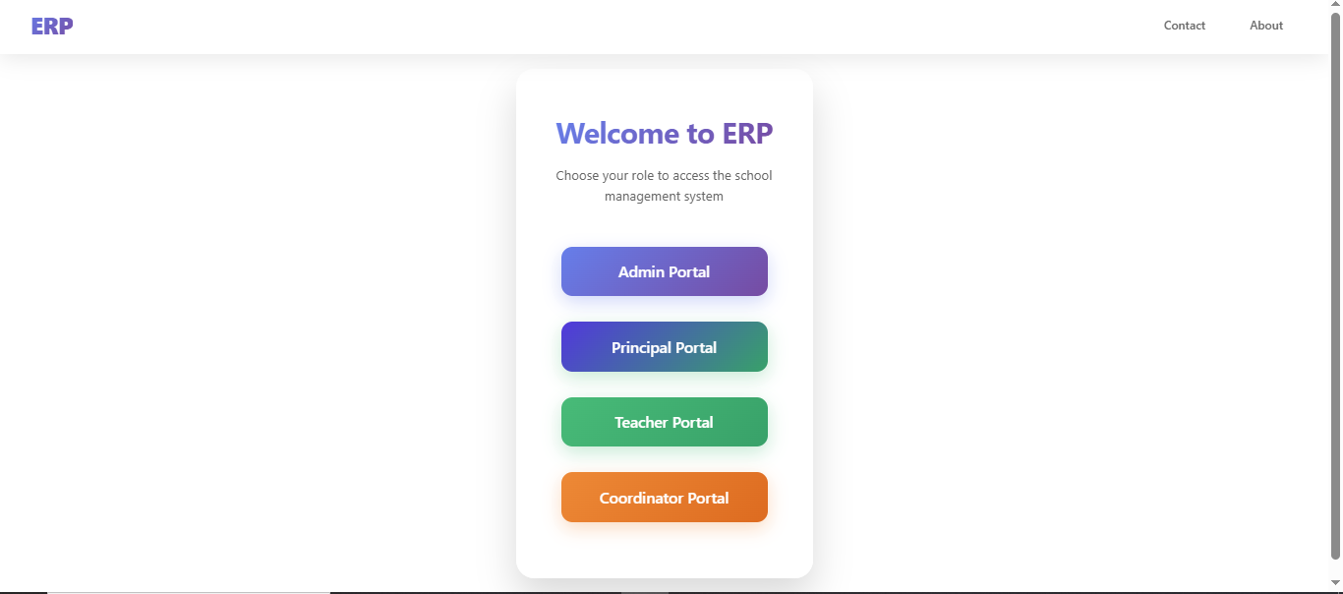
Screen-Shots

Slide 9
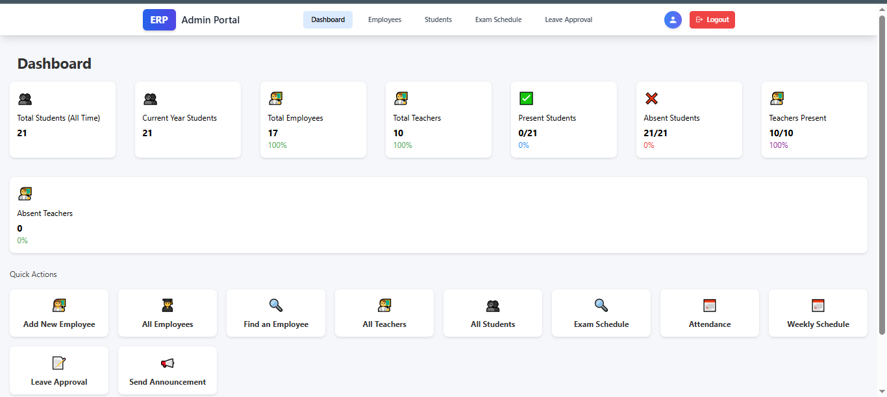

Slide 10
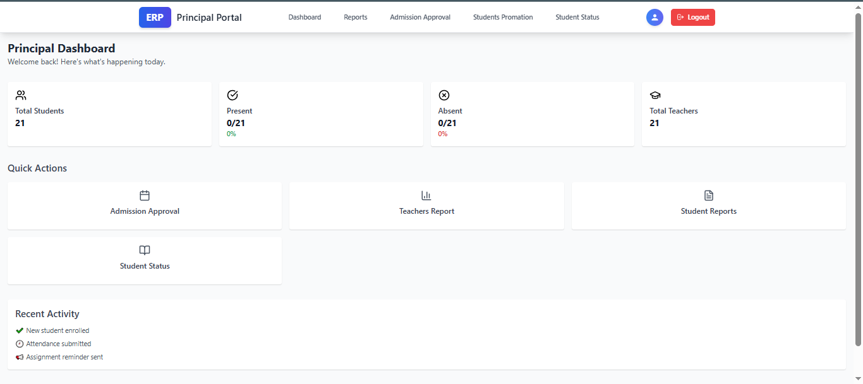

Slide 11
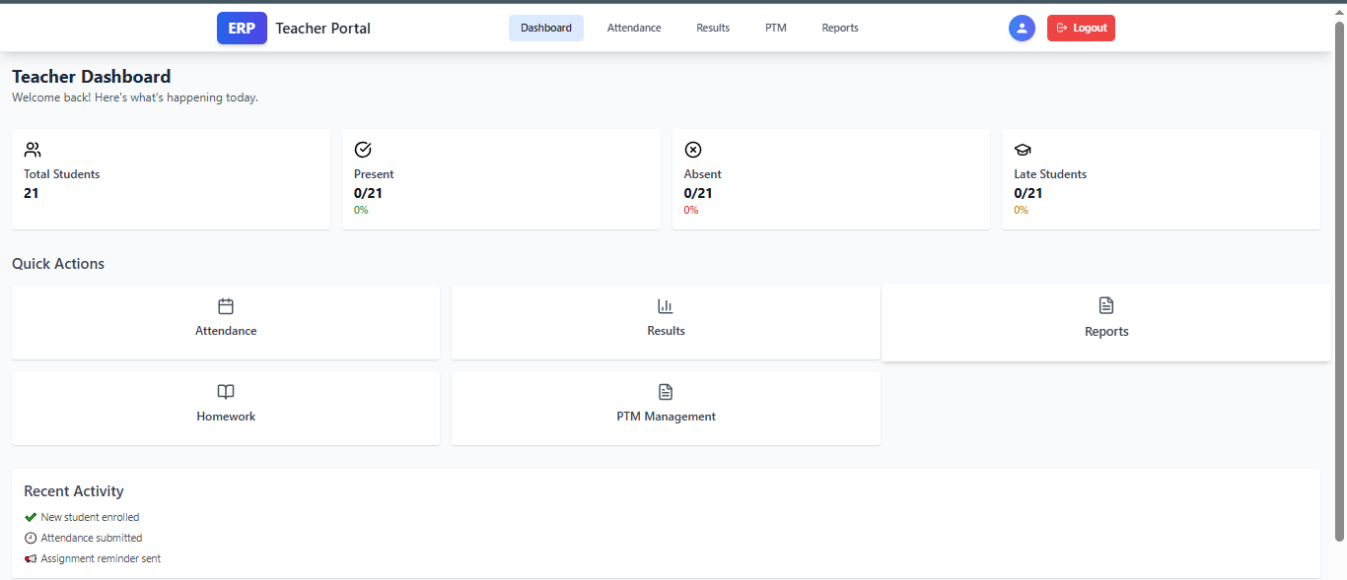

Slide 12
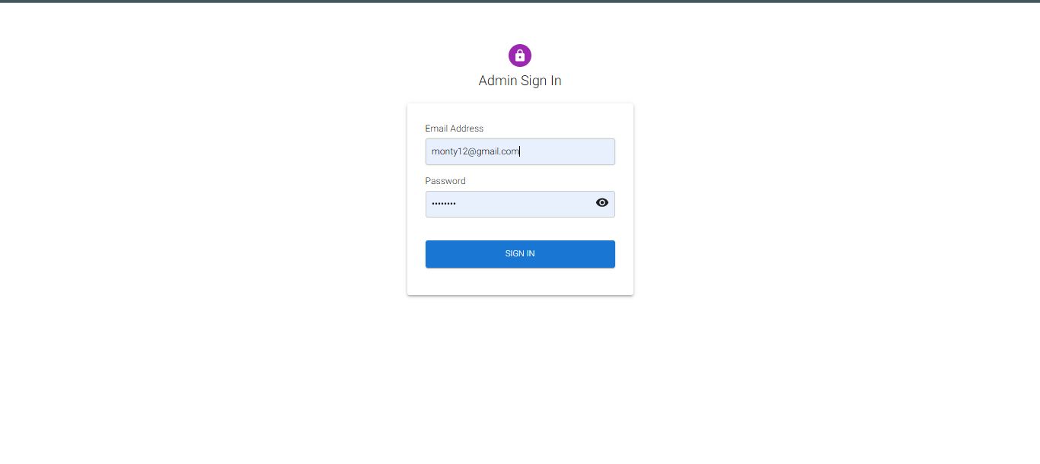

Slide 13
Conclusion & Future Scope
The ERP system will simplify academic and administrative workflows.
MERN technology provides scalability, speed, and flexibility.
Thank You!

